Slide 1
Face Emotional Recognition
Zijun Wang (Allen), Fei Xiong
Prof. Linda M. Sellis
CS-UY 4563
12/20/2022

Slide 2
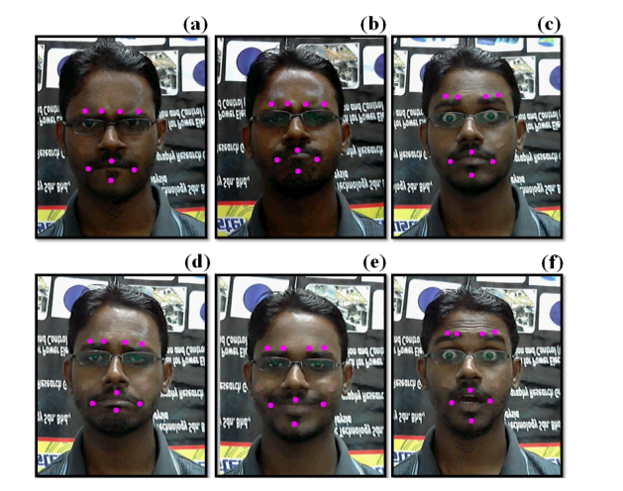
Introduction
e1
e3
e4
e2
Facial Emotion Recognition Dataset
Multi-class classification problem
10 features: Distance between virtual and center markers
6 classes: Happiness, Sadness, Anger, Fear, Disgust, Surprise
Models Used
Logistic
Support Vector Machine (SVM)
Neural Networks
m2
m1
m6
m4
Figure 1: Virtual Markers

Slide 3
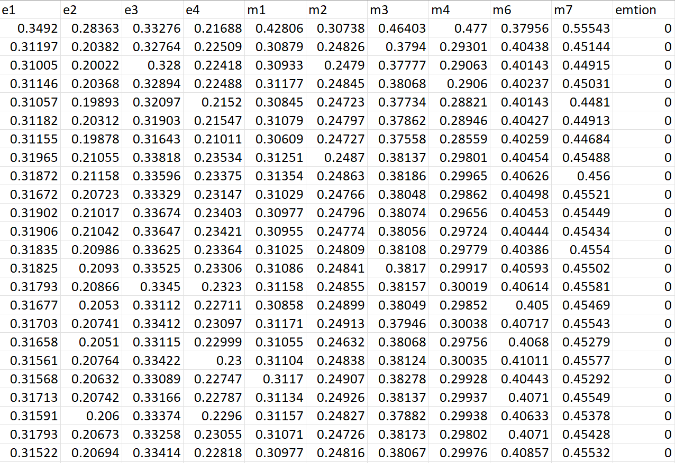
Figure 2: Dataset

Slide 4
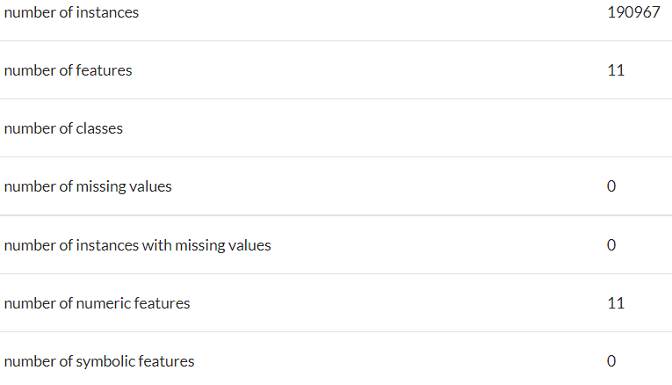
Preprocessing
Balanced Dataset
No incomplete features
190967 instances, 11 columns
75% train, 25% test
Figure 3: Dataset Information on openML

Slide 5
Logistic Regression
Feature adding:
Combinations ! (Brute-Force)
Divide and multiply current feature with next 1 to 5 features together -> 1264 features
Feature deletion:
delete features that weights smaller than 0.5 in at least 3 classes -> 550 features
Transformation: Square, Square root

Slide 6
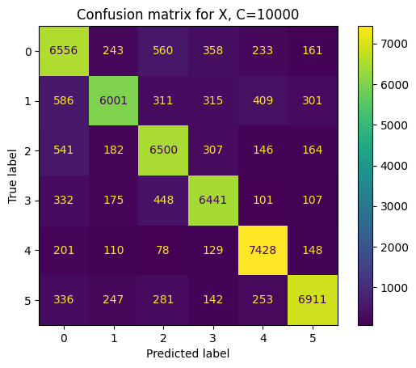
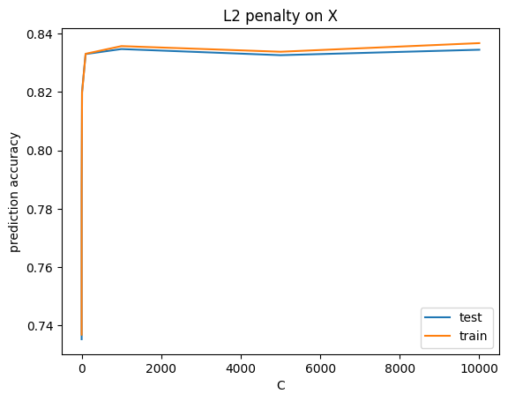
Logistic Regression
Sklearn Function
LogisticRegression(multi_class='multinomial', solver='lbfgs', penalty="l2")
Scaling: StandardScalar()
L2 Regularization
C=[0.1,0.5,10,100,1000,10000,10000]
Best Accuracy: 83.46%
Figure 4: Confusion matrix
Figure 5: L2 penalty on the square root of the data set

Slide 7
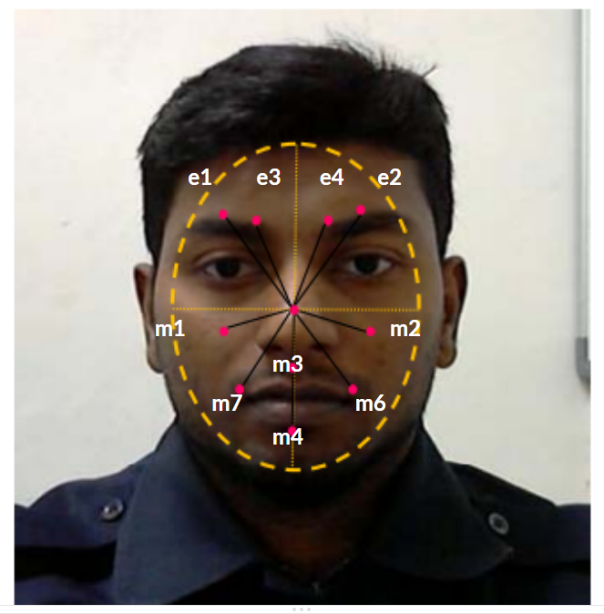
Interesting Finding
Based on the most weighted features in different classes:
Anger and disgust are related much more to eyes
Fear, sad, happy, and surprise are related more to mouths, especially for sad.
M2 stands out for surprise
Figure 6: Virtual and center markers

Slide 8
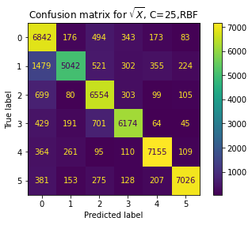
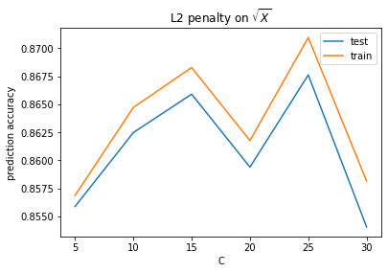
Support Vector Machine(SVM)
Sklearn Function: sklearn.svm.SVC()
Scaling: StandardScalar()
Transformation: Square, Square root
Kernel: RBF
L2 Regularization: C=[5,10,15,20,25]
Best Accuracy: 86.76%
Figure 7: Confusion matrix
Figure 8: L2 penalty on the square root of the data set

Slide 9
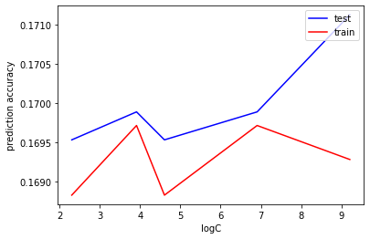
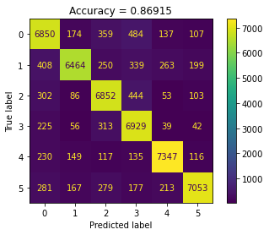
Neural Network
Sklearn.neural_network.MLPClassifier
L2 regularization
Choices of hyperparameters:
[0.0001, 0.001. 0.01, 0.1, 1, 10, 100, 1000]
[0.0001, 0.001, 0.01, 0.1, 1]
Activation functions for hidden layers: Logistic, ReLU, Tanh
Figure 9: C = [10, 50, 100, 1000, 10000]
Figure 10: Confusion Matrix for X, C=0.0001

Slide 10
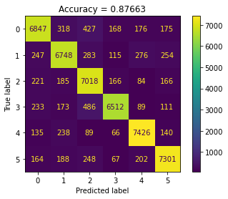

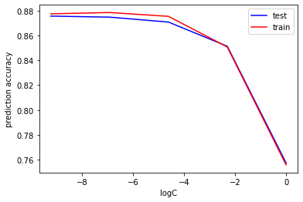
Neural Networks
Layers Settings:
3 Layer: 10 - 40 - 1
4 Layer: 10 - 40 - 20 - 1
5 Layer: 10 - 80 - 40 - 20 - 1
Best Model: 5 layers, L2 regularization, ReLU, C=0.0001
Best Accuracy: 87.57%
Slight difference between different transformation
Figure 11: Confusion Matrix for X^2, C=0.0001
Figure 12: Confusion Matrix for X^(½), C=0.0001
Figure 13: ReLU, hidden layers = (80, 40, 20)

Slide 11
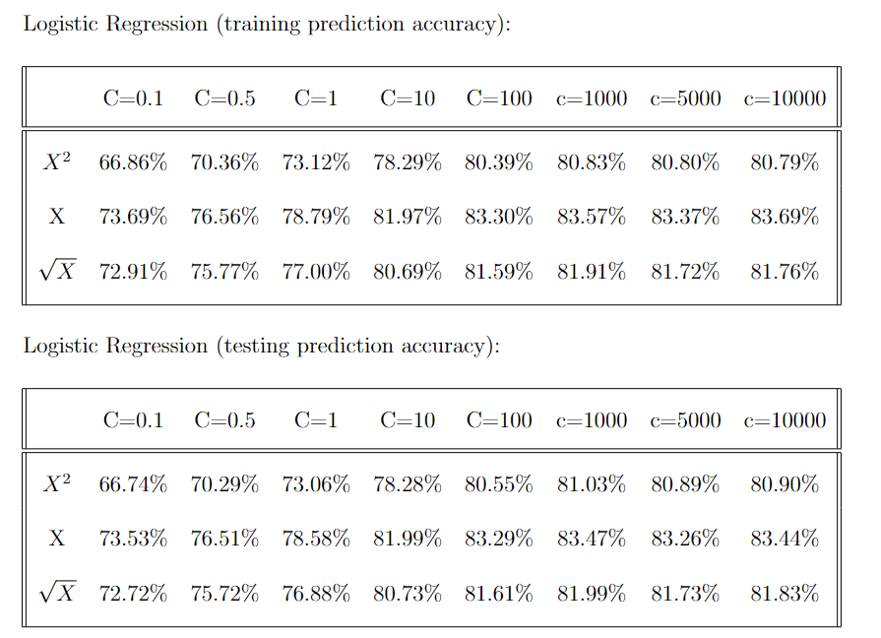
Results
Table 1: Test prediction accuracy result

Slide 12
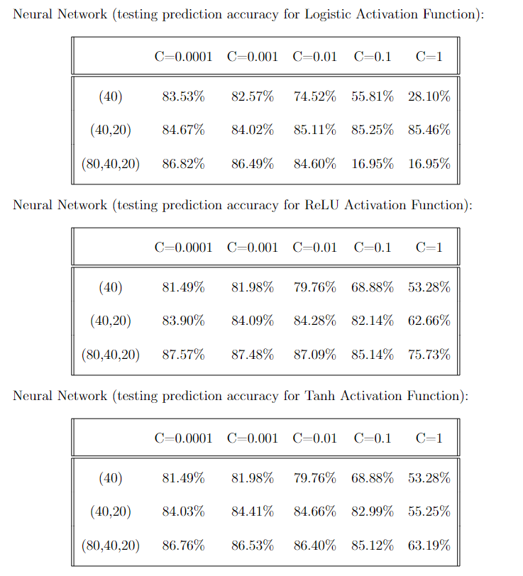
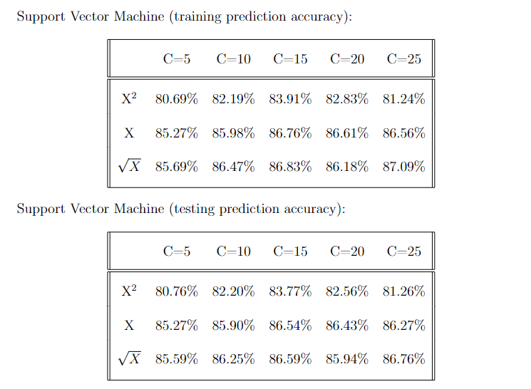
Results
Table 2: Test prediction accuracy result

Slide 13
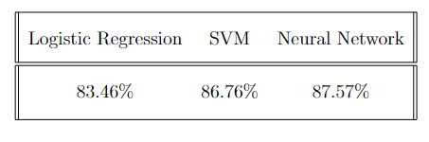
Conclusion
Neural Network with 3 hidden layers , ReLU activation function, C=0.0001 has the best accuracy
Three models have similar precision accuracy
Potential Improvement:
Test more hyperparameter values
More Layers of Neural Network
Remove outliers
Table 3: Best test prediction accuracy comparison

Slide 14
Works Cited
Face Emotion Recognition Dataset:
https://www.openml.org/search?type=datastatus=activeid=43602sort=runs
Virtual Markers based Facial Emotion Recognition using ELM and PNN Classifiers:
https://ieeexplore.ieee.org/document/9068708
Optimal Geometrical Set for Automated Marker Placement to Virtualized Real-Time Facial Emotions:
https://journals.plos.org/plosone/article?id=10.1371/journal.pone.0149003
sklearn neural network documentation:
https://scikit-learn.org/stable/modules/classes.html#module-sklearn.neural network
sklearn support vector machine documentation:
https://scikit-learn.org/stable/modules/generated/sklearn.svm.SVC.html
sklearn logistic regression documentation:
https://scikit-learn.org/stable/modules/generated/sklearn.linear model.LogisticRegression.html

